Slide 1



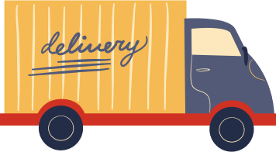



BUAN 6346.501 - Big Data - F24​
Az National Trucking (ANT) Data Analysis
Presented by: GROUP 10:
Abhinav Sahu (AXS230123)
Abhishek Dubey (AXD220145)
Kajal Singhal (KXS220094)
Sanjana Sasi (SXS230075)
Subodh Kadam (SXK230012)

Slide 2
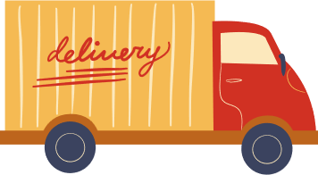
Problem Statement
ANT is a decade old organization with a total of 400 employees working in the long-distance trucking services
As fleet managers, we must analyze the large number of accidents involving trucks to make all fleet drivers comply with company regulations and do not pose insurance risk.
Objective
To enhance ANT's safety and efficiency through detailed data analysis by utilizing a blend of data sources including HDFS, Pig, Tableau, and R-studio
Setting targets to improve driver training and vehicle deployment strategies based on data-driven insights

Slide 3

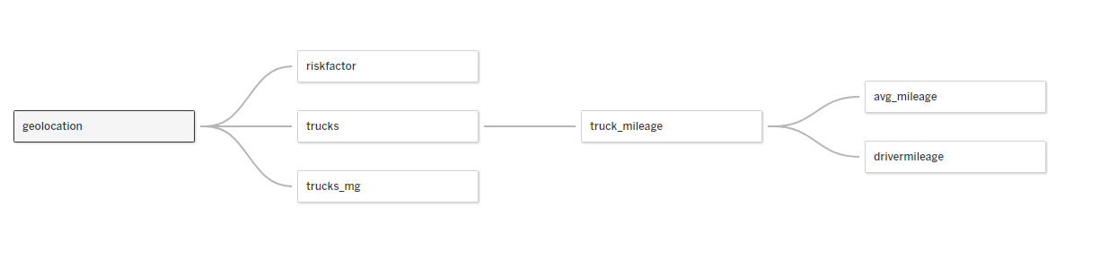
Dataset Description

Slide 4


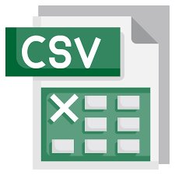











Data Workflow
5 - Pig
Creating the riskfactor table and populating the table using PIG
1 - CSV
2 - VMware
3 - HDFS
4 - Impala
6 - Tableau
Download and save the csv files on local system
Move the files to VMware​
Moving files from local directory to HDFS
Import data in Impala​
Using ODBC driver importing tables in Tableau​
7 – R-studio
Applied linear regression to forecast risk factor

Slide 5
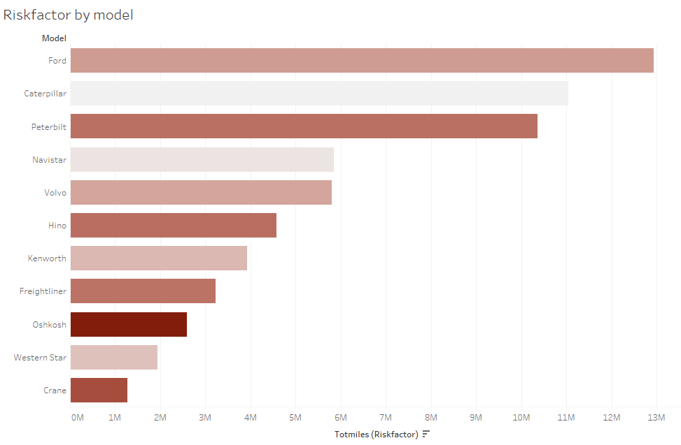
1. Which models are more prone to risk events?
Certain models have higher overall risk factors, which could be due to various reasons, such as the design of the vehicle or the typical use case of that model
Caterpillar shines as the top model despite ranking second in total miles, showcasing the lowest risk factor and underscoring the significance of its risk management strategies

Slide 6
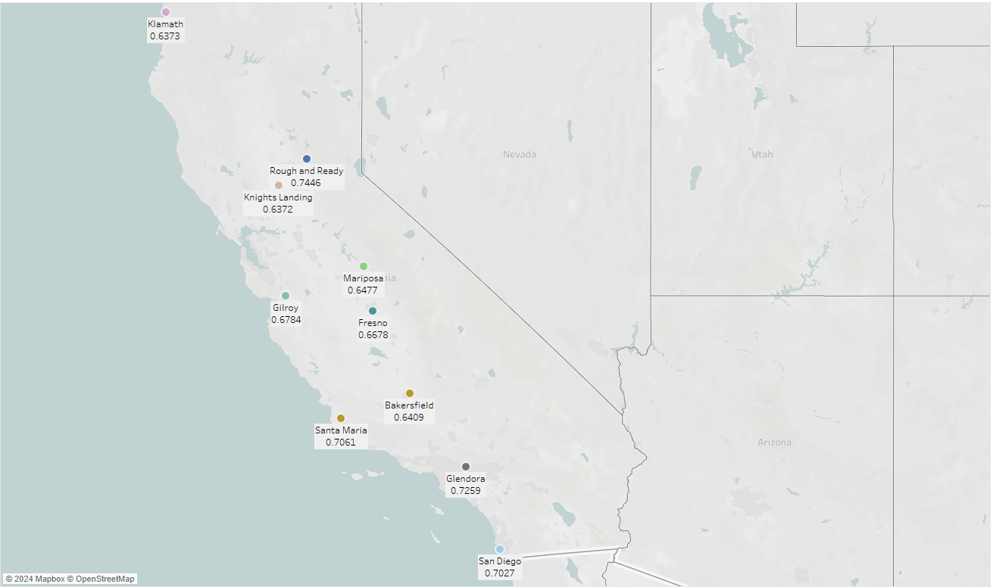
2. What are the top 10 riskiest cities?
Rough & Ready having the highest risk factor followed by Glendora suggests these areas have room for improvement
Moreover, drivers in these cities should be well-trained to mitigate such events in the future

Slide 7
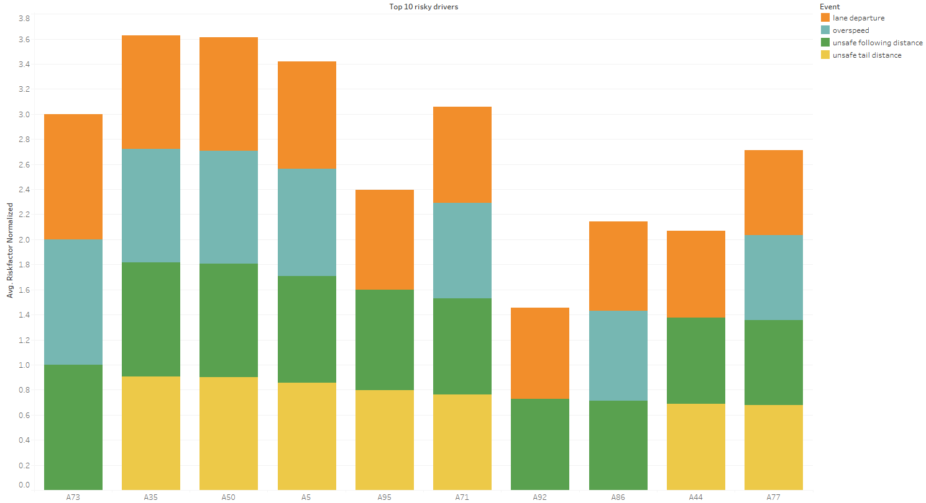
3. What types of risk events are most common among the top 10 riskier drivers?
All drivers exhibit multiple types of events, but over speeding and unsafe following distance appear to be common across many of the drivers
Some drivers show particularly high levels of unsafe following distance, which could be targeted for immediate intervention
Comparing this graph with previous visualizations, if these drivers correspond to certain vehicle models or operate in specific cities, it could indicate where to focus safety improvements or driver training initiatives

Slide 8
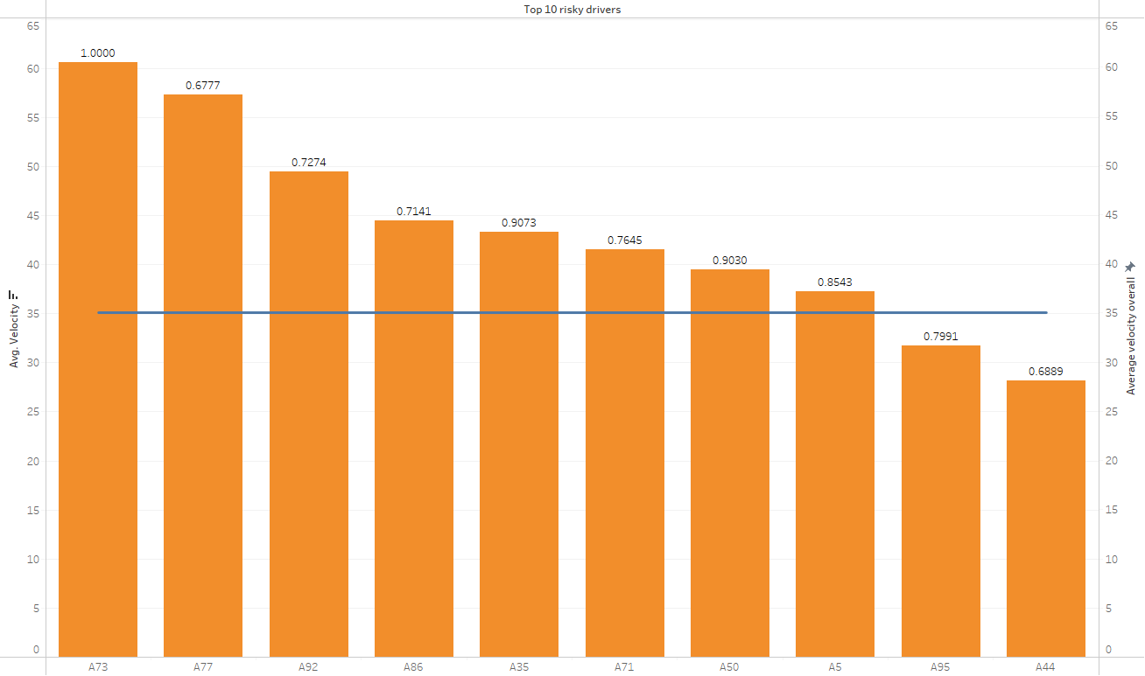
4. What is the average velocity of top 10 riskier drivers?
Risky drivers often drive too fast, increasing their chances of accidents
Eight out of ten drivers exceed the average speed, highlighting speeding as a major issue for them
Overspeeding can be mitigated by implementing speed monitoring systems, providing regular driver training on safe driving practices, incentivizing adherence to speed limits, and employing technologies like speed limiters to cap vehicle speeds

Slide 9
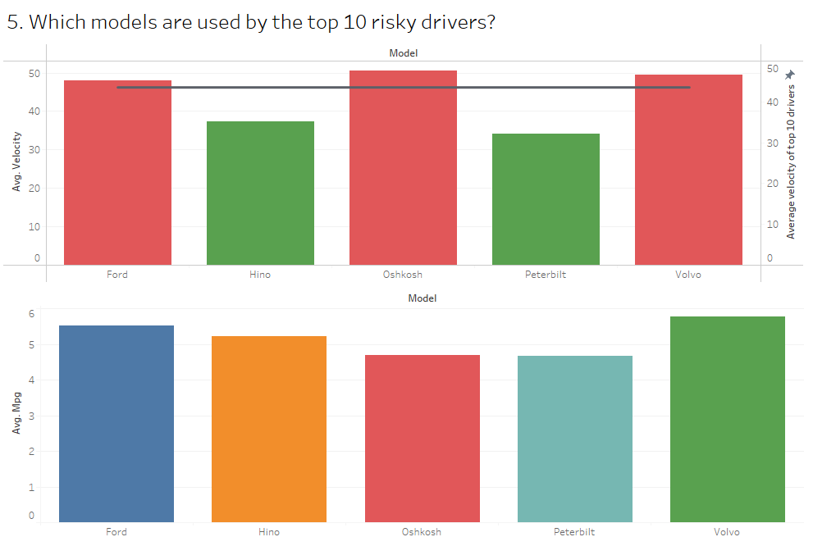
5. What are the optimal operational measures for top 10 risky drivers based on models?
Among the models assessed, Oshkosh exhibit highest average velocity but lowest MPG , indicating potential in-efficiencies in model overall performance requiring improvements.​
Among the models , Ford, and Volvo exhibit excellent average velocities and high MPG , indicating that these models are provide overall best performance in terms of operational and fuel-efficiencies. ​
Hino stands out for delivering superior mileage while maintaining average speeds below the threshold. We propose expanding the utilization of Hino for frequent-stop/interval distribution routes.​
​
Similarly ,Peterbilt, although slightly trailing behind Oshkosh in mileage, demonstrates below average speeds, indicating potential in-efficiencies requiring improvements.​​
Implementing these strategies can enhance operational efficiency in the trucking system while mitigating associated risks.​

Slide 10
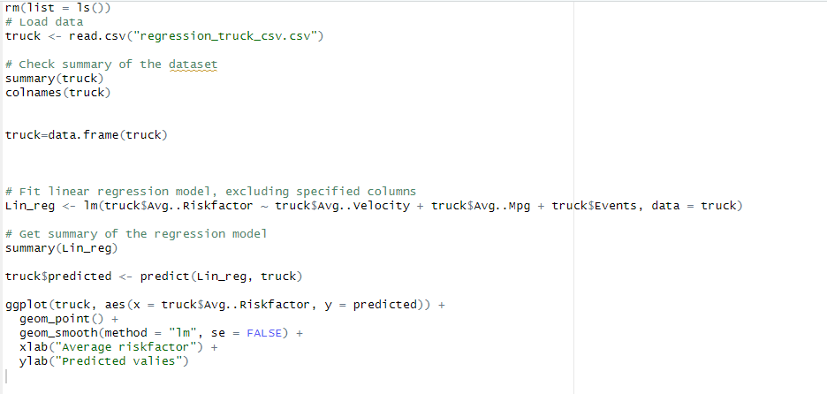
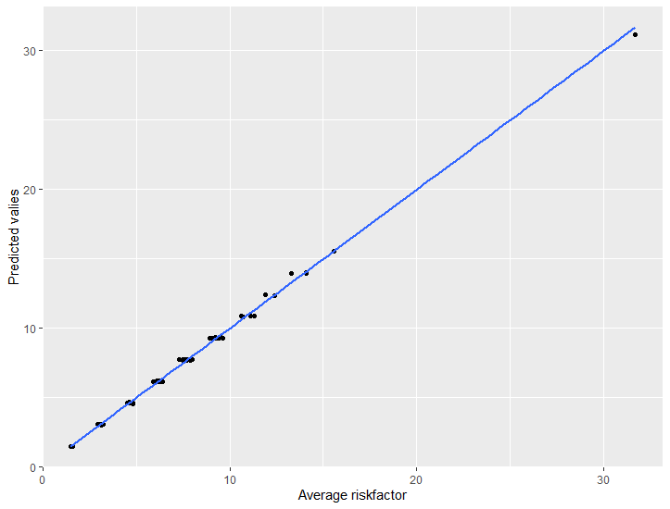
Linear Regression
Integrated Tableau’s table visualization with R to generate linear regression model
Adjusted R-squared: 0.9977

Slide 11
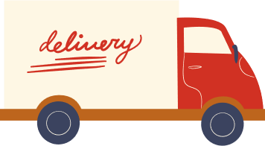
Conclusion
Identified specific truck models and driver behaviors that elevate risk levels; suggested improvements based on linear regression outputs
Urging the implementation of specialized training programs to mitigate identified risky driving practices
Recommending strategic deployment of Hino trucks on longer routes due to their lower MPG
Key challenge: Integrating R with Tableau was key challenge faced

Slide 12
Thank You

